Slide 1
Spanish Missions in TX—Cornell Notes
Why did the Spanish build mission and forts (presidios) in Texas?
Describe the culture that developed within the missions?
What was the first mission in San Antonio, Texas?
How would we define a mission?
Why was ranching important to missions?
What happened to the missions when the Franciscan priests left?
Write Me in your Journal!!!

Slide 3
Partner Work
Using your Text Book p. 112-113 (next 2 slides) & a Partner Complete the Mission Map WS

Slide 4
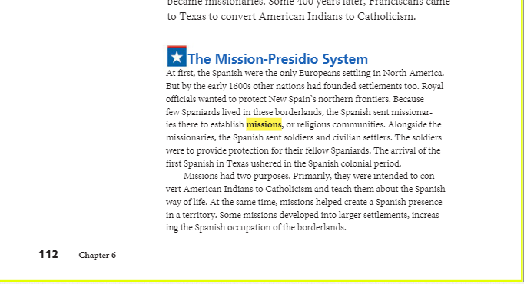

Slide 5
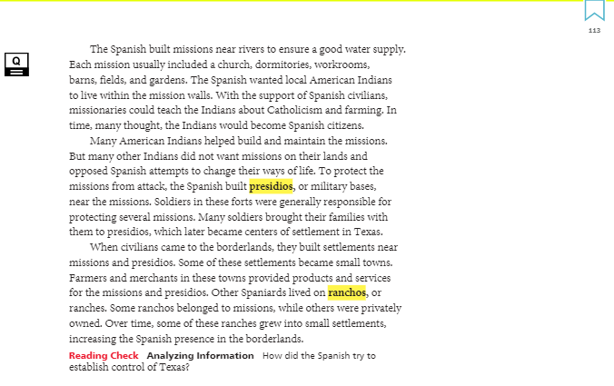

Slide 6
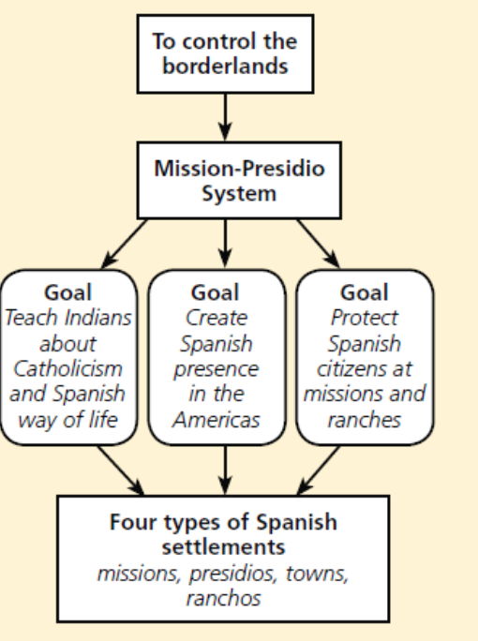
What were three goals of the mission-presidio system?
What were the four types of Spanish settlements?
Add to Cornell Notes

Slide 7
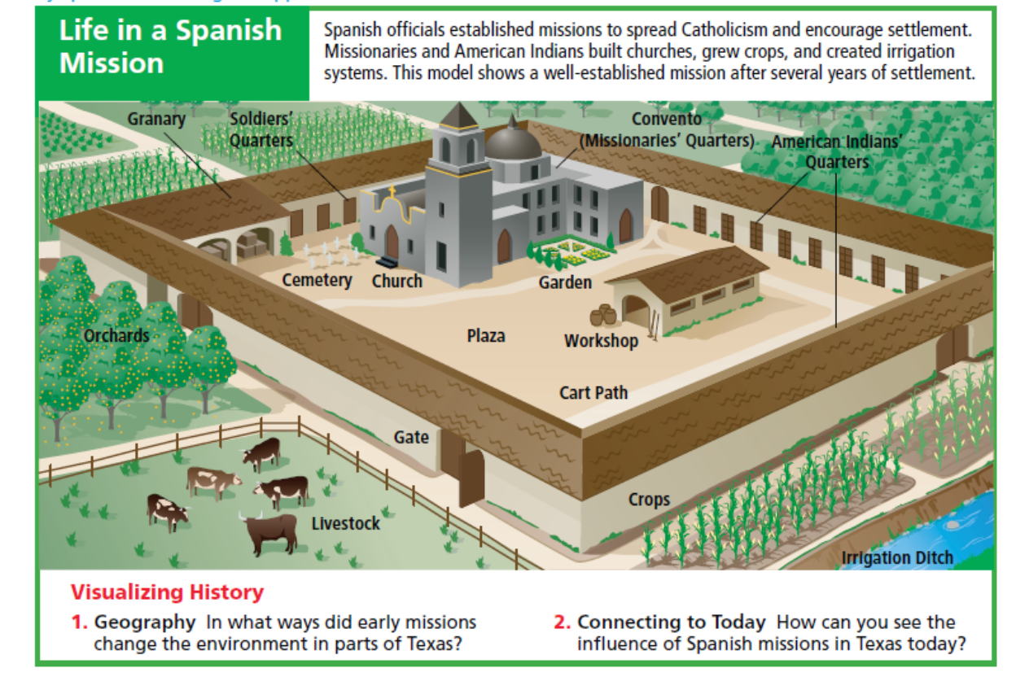

Slide 8
